Slide 1

Black Friday Tweets Analysis
MIS 6382.502 Project Presentation
Group-7
Rohan Srinivas
Kruthagama Divakar
Harshal A Deokar
Prathamesh R Kalwar

Slide 2
Dataset Introduction Source:
These days, social media usage has reached its peak of excellence and is used for global marketing.
Twitter is one such social network through which people share their sentiments and opinions.
The Dataset we have selected consists of tweets from twitter-users from all over the world, each of these tweets are about the most popular shopping season: BlackFriday!
Including a hashtag gives one’s Tweet context and allows people to easily follow topics that they're interested in, and our dataset has posts which contain #blackfriday.
We will be utilizing username, location, user account creation date, user followers, user following, likes, date the post was uploaded, hashtags and source to carry out our analysis.

Slide 3
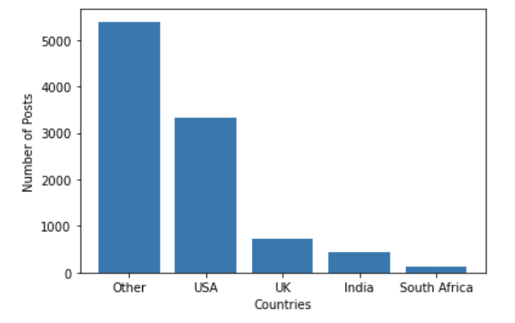
Bar Graph
The dataset contains tweets from users all over the world
A depiction of the number of tweets per country is seen in the bar graph
In this Discussion, for more detailed analysis, we are only selecting posts from UK

Slide 4
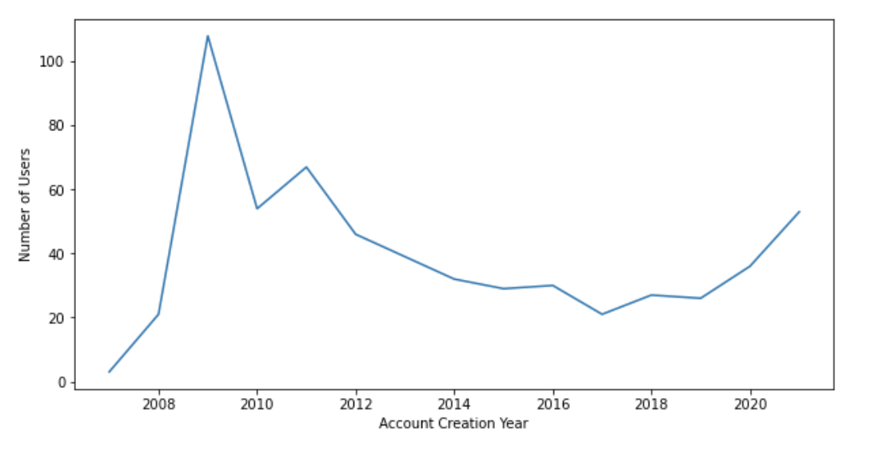
Line Graph
Twitter started getting popular between 2008 and 2010, we can see this trend in our line graph too.
We also observe that in UK, the number of account created has also been increasing since 2019.
This assures us that more and more people in UK are using twitter to share their thoughts and opinions.

Slide 5
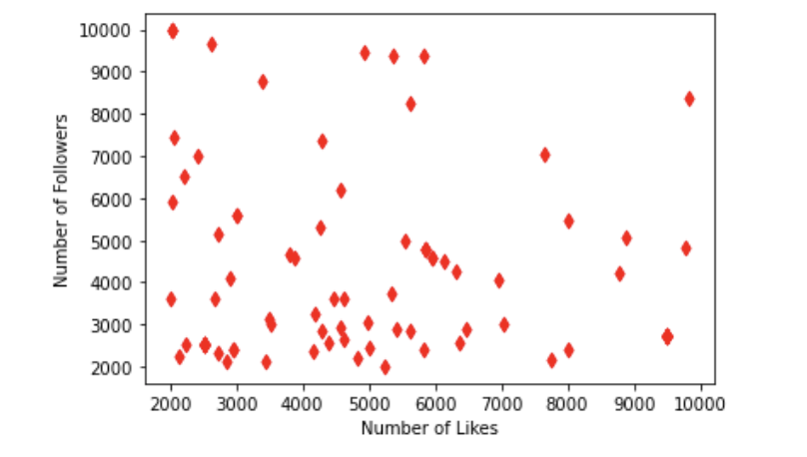
Scatter Plots
When we restrict our analysis to the general public i.e for users who have a fairly decent number of followers
It is seen that the users with lower number of followers the number of likes is also relatively low

Slide 6
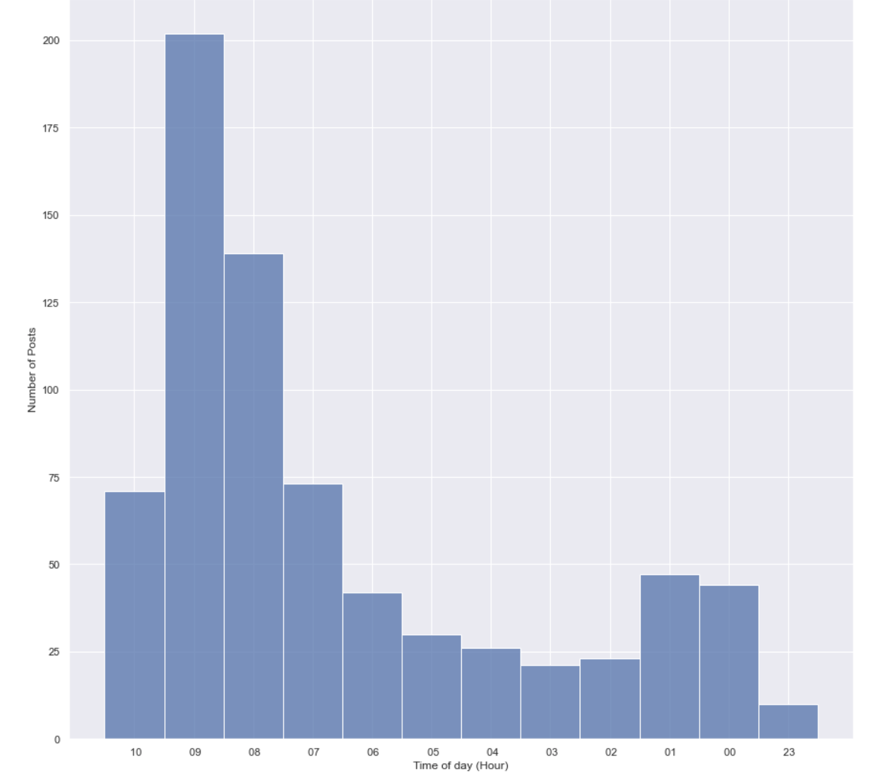
Histogram
Through this graph we can observe
at what time these tweets were posts.
It is evident that the maximum activity
was between 8 am to 9 am on the day
of the sale

Slide 7
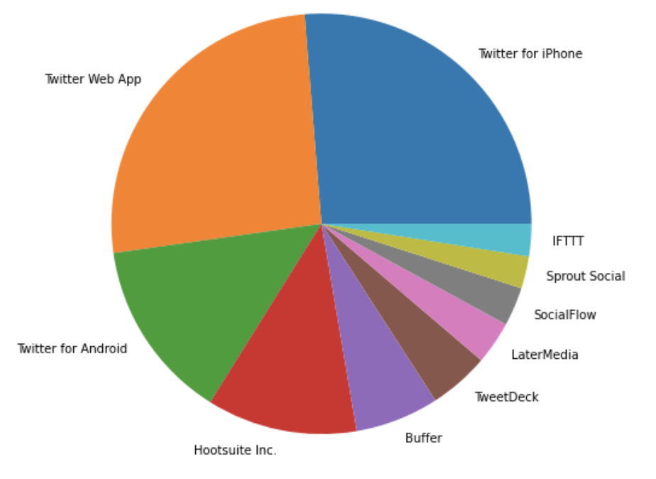
Pie Chart
For number of tweets from different sources
Most popular medium for posting tweets is iphone,webapp and Android
Most popular social media and marketing tool in UK is Hootsuite Inc

Slide 8
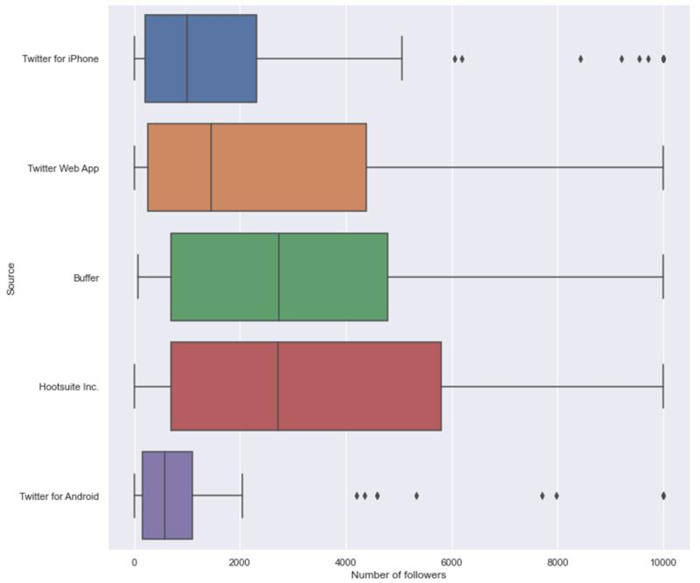
Box Plot
When we compare the Hootsuite Inc and Buffer, the two major social media marketing companies in UK, we see Hootsuite Inc has a wider ranger of followers and a higher median.

Slide 9
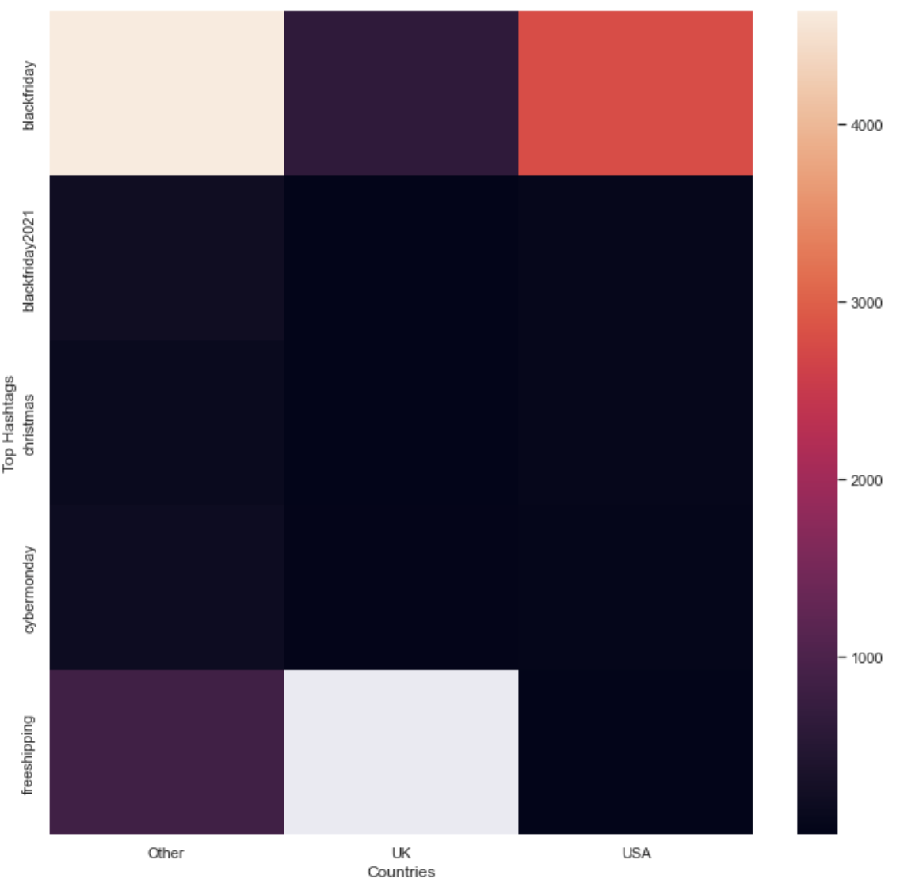
Heat Map
When we compare the number of posts with top hastags in each country
We see that #freeshipping is not being used in UK at all
#blackfriday2021 is more prominent than the general #blackfriday

Slide 10
Conclusion
Through the various visualizations for UK we are able to understand the trends in
Increasing approval of twitter
Popularity of BlackFriday sale
Tweet Activity
Marketable sources to post tweets
Hashtag usage
These can be utilized by businesses to come up with winning marketing strategies.

Slide 11
Recommendation
A strategy can be devised to increase the number of likes per post among users with moderate followers, this will help popularize the tweets.
Social Media marketing companies can use the 8am to 10am slot on the day of the sale for promotional activity as this is the time when most users are posting about BlackFriday sale.
Businesses in UK can utilise Hootsuite Inc to post their tweets about BlackFriday sale, since Hootsuite Inc has a higher range of followers.
#freeshipping is not used in UK at all, businesses can consider this and start offering free shipping option to drive sales.

Slide 12
Thank You

